Slide 1
Chapter 9
Subprogram Control
abhijit.comp@coep.ac.in

Slide 2
This Chapter focuses on ...
Code Generation to ensure
  LIFO order of function calls
  Access to proper local or global variables
  Recursion works
  Parameter passing works

Slide 3
Let's assume: Subprogram call-return sequences with
No Recursion
  Some languages do not support recursion!
Every function is called explicitly
  Exception handler programs are called automatically
Function runs from start to end always
  Coroutines starts from last point
Immediate transfer of call
  Scheduled function calls in some languages
Single execution sequence
  Only one functino running at a time
C language has all these features except “no recursion”. So we are discussing implementation of a C like language.

Slide 4
Subprogram activation
Code Segment
  Function code area in the memory
  Also contains the constants
  Does not change
Activation Record
  Memory for local variables, parameters, temporaries, etc.
The activation keeps changing
Code For
the Function
Memory for
local variables,
parameters,
temporaries, etc.

Slide 5
Call-Return sequence
Execution of a statement S during activation R
  A function may be called many times during the life of a program, so say activation “R”
On a function call Need to remember
  Current Instruction the calling program (an address = a pointer)
    Where to return back ?
  Location of activation record (an address = a pointer)
    Where are “previous” variables ?
  Compiler generates code before and after the function's code to “store” and “restore” these two “pointers”
    Called prologue and epilogue respectively

Slide 6
CIP and CEP
Two names for the two pointers we discussed
Current Instruction Pointer (CIP)
  Points to the instruction currently being executed
  Equivalent of processor's Program Counter Register
Current Environment Pointer (CEP)
  Pointer to current activation record
  Access to a local variable will be as an offset from the location of CEP

Slide 7
Function main()
Function A()
Function B()
....
CALL A
....
CALL B
......
CALL A
.......
Constants
...
CALL B
......
Constants
I5
Return
Constants
I1
I4
I2
R3
I4
R2
Local Vars, etc
R2
I1
R1
Local Vars, etc
CEP
R3
R1
---
CIP
I5
----
Local Vars, etc

Slide 8
Function main()
Function A()
Function B()
....
CALL A
....
CALL B
......
CALL A
.......
Constants
...
CALL B
......
Constants
I5
Return
Constants
I1
I4
I2
R3
I4
R2
Local Vars, etc
R2
I1
R1
R1
CEP
R2
Local Vars, etc
R3
R1
---
I1-1
----
Function main() running, just before calling A()
CIP
I4-1
Local Vars, etc
I5

Slide 9
Subprogram calls in action
On a call
  Save the previous CIP (=call instruction + 1) and CEP
  Create activation record for the function
  CIP = first instruction of new function
  CEP = new activation record created
On a return
  CIP = saved CIP
  CEP = saved CEP

Slide 10
Another Implementation
In first implementation
  Activation records created on function call
  If no recursion, at a time only one activation of a function in existence
So we can “preallocate” all activation records
  Compiler makes provision for space along with code segment
  No need of CEP now, as the compiler can generate a reference
  Needs more space though

Slide 11
Stack based implementation
The creation and deletion of activation records (first implementation) needs to be done in LIFO manner
Most processors today have support for a stack
  Stack pointer (a register), push and pop instructions
So the first scheme can be integrated easily with system stack

Slide 12
System Data,
including Static
chain pointer
Subprogram Code
Segments and system
Code segments
Return point location
Activation
record storage
Formal Parameters
Stack top(growth)
Allocated by
Subprogram invocation
Local variables
Free Space
Temporaries for
Expression evaluation
Heap Growth
(allocated by malloc)
Heap bottom
Temporaries for
parameter transmission
Activation Record
Memory organization during execution
C Memory Organization

Slide 13
int main () {
int a, b, c;
X: c = f (a, b);
return c++;
}
int f (int x, int y) {
int m;
x = y + 10;
Y: m =g(x)
return m;
}
int g(int p ) {
int h;
h = j*2 + p
return h;
}
Previous E.P
Previous I.P.
Activation Record
for main()
a
b
c
E.P. of main()
Stack Pointer
I.P. in main(), X
x
Activation Record
for f()
y
m
E.P. Of f()
I.P. in f(), Y
Activation Record
for g()
p
{temp}
h

Slide 14
Implementing recursion
With stack based implementation nothing new needs to be done
  Only difference is “recursion creates another activation record during the lifetime of first activation”
  Otherwise it is just like another function call
The saved CEPs (or eps) create a chain – called the dynamic chain
If the language does not support recursion, compiler can choose either first or second implementation
  Languages like PL/I require functions to be be tagged RECURSIVE so that they can select implementation

Slide 15
Demo of subroutine control

Slide 16
Pascal Forward Declaration
One pass compiler
  Compiler that compiles by reading source code ONLY ONCE
  Supposedly to increase speed of compilation
Problem of generating code for a function defined ahead in the source file
  Pascal solution: forward declaration
  Procedure A(parameters) ; forward

Slide 17
Data Control

Slide 18
What is data control ?
Local and global variables with same name, which one to access?
How to pass parameters ? How to implement pass by value ?

Slide 19
Various possible names in a program
Variables int x;
Formal parameters f(int a)
Subprograms/Functions int f(float g);
Types typedef struct stack {...}stack;
Constants
#define PI 3.14;
Statement labels
  P: Y = 10;
  if (x > 10)
    Goto p; else y++;
Exceptions
Primitive operations ( + * SQRT)
Literal Constants (1.2, 3, etc.)
Our interest is in variable, formal paramter and subprogram names in this chapter

Slide 20
Association and Referencing Environment
Data Control
  Binding of identifier(names) to data objects
  Such a binding is called “association”
Every subprogram invocation creates a new set of associations
  Some are created on entry to subprogram (local vars), some may already exist(globals)
  New associations destroyed on return and old associations restored

Slide 21
Referencing Environments
R.E = Set of associations available for use in referencing in a subroutine
Local Referencing Environment
  Set of associations created on entry to subprogram: formal parameters, local variables, etc
Nonlocal Referencing Environment
  Set of associations NOT created on entry to a subprogram
Global Referencing Environment
  Associations created at the start of execution of main program
  Global R.E. is a part of Nonlocal R.E.
Predefined Referencing Environment
  Defined by language.

Slide 22
R.E. Example
program main;
var A,B,C: real;
procedure Sub1(A:real);
var D: real;
procedure Sub2 (C:real);
var D: real;
begin
D = 5.0;
C = D + B;
D = C + 3;
end
begin{Sub1}
A = 3;
Sub2(B);
end
begin{Main}
C = 3;
Sub1(A);
A = C;
end
R.E. For Sub2
  Local: C,D
  Nonlocal: A, Sub2
  Global: B, Sub1
R.E. For Sub1
  Local: A, D, Sub2
  Nonlocal: B,C,Sub1
R.E. For main
  Local: A, B,C,Sub1

Slide 23
Visibility
Association is visible if it is part of the R.E.
  In C an association is visible if it is either local to the function or a global declaration
  Local redeclaration of a global association, hides the global association (global is not visible)
  int x;
  main () { int y, x; y = 5; x = 10; }
  f() { x = 11};
  Which X is visible ?

Slide 24
Aliases
Data object available in a single R.E. Through more than one name
int x
int f (int *y) {
x = *y + 1;
    // x and *y are aliases
}
main( ) { f(&x); }

Slide 25
Scope
Scope of an association is set of subprograms in which it is visible
  Statically determined or/and
  Dynamically determined

Slide 26
Dynamic Scope for an association
Set of subprogram activations in which the association is visible during execution
Dynamic scope rule, one example: scope of an association includes the subroutine P() that created it and all subroutines calls that P() will effect
Dynamic scope rule in C: association visible only in the creator subroutine.

Slide 27
Example of Dynamic Scope rule
p( ) {
int x;
q()
} //CODE FROM SOME LANGUAGE
q() { int y;
y = x+ 5;
z();
}
z() {
y = x +1;
}
In Function q(), y is the local variable, while x is the variable from p()
In function z, y is from function q(), while x is from function p()

Slide 28
Static Scope for a declaration
That part of program text where use of an identifier refers to this particular association
Compile time scope
Static scope rule, an example: Reference to a variable X in function P() refers to X declared in P() or if not declared then to X declared in Q() which “includes” P() or so on till you reach global declaration
Static scope rule for C: Search for a variable in current function then globally, else not found.

Slide 29
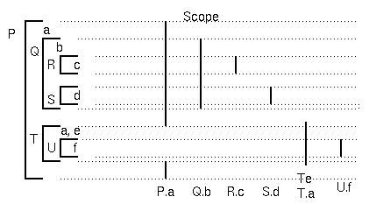
Static Scope rule in Pascal
Pascal allows function nesting
P Q R S T U are functions
a b c d e f are variables

Slide 30
Importance of static scope fule
Suppose no static scope rule
  Compiler can not determine at compilation time which variable is being referred to.
    int x = 8;
    f( ) { int y = x; }
    p( ) { string x =”abc”; f( ); }
    q( ) { int x = 10; f( );}
  For every invocation of f() the interpreter will check the sequence of function calls and determine the association for x → Expensive.
LISP, SNOBOL4, APL have no static scope rule!

Slide 31
Importance of static scope fule
Static type checking can be done
  p() calling f() on earlier slide
  Programs become more reliable
Same rule makes connections between type name to type declarations, relating function calls to function function declarations, etc.
They make program easier to understand.

Slide 32
Block Structure
Block: A new referencing environment
Block Structured languages
  Program is organizes as a setof nested blocks
  Static scope rules associated with it
Pascal: Each subroutine is a block
C: Functions are blocks, blocks within functions are defined using curly braces { }
  Demo

Slide 33
Static scope rules for block structured programs
Reference to identifier within body of block is to a local declaration if one exists
If no local declaration, then reference is to a declaration within immediately enclosing block, and so on
Outer block can't access inner block's declarations
A block name is a part of R.E. Of the enclosing block

Slide 34
Parameter Transmission

Slide 35
Some definitions
Protocol
Return Type
int myfunc(char c, float f, int *p)
{
c = 'a';
f = 1.5
}
myfunc('a', 2.5, &i);
int myfunc(char c, float f, int *p);
Parameter Profile
Header
Subprogram definition
Subprogram call
Formal parameter
Actual parameter
Subprogram declaration

Slide 36
Marrying formal parameters to actual parameters
Positional
int premium(float interest, float loan)
{
}
premium(10.5, 30000.5);
Actual paramters written in same order as formal parameters
What if the call is written as
premium (30000.5, 10.5)
Likely to happen with long argument lists!

Slide 37
Marrying formal parameters to actual parameters
Keyword based
Use name of formal paramters in the call statement
premium(interest => 10.5, loan => 30000.5);
Advantage: No need to remember order
Disadvntage: Need to remember formal argument names

Slide 38
Marrying formal parameters to actual parameters
Mixed mode
f ( int a, char b, char c, float d)
{
}
f ( 1, b => 'm', c => 't', d => 1.5);
f (123, 'm', c => 'a', d=> 3.50090) ;
Once a keyword parameter appears, all following must be keyword parameters

Slide 39
Number of arguments
Fixed
  int f( int c, char *p ) {
  }
Variable
  int f (int c, char *p, ... )
  e.g. printf !

Slide 40
Implementing data transfer or Parameter Passing
Pass by value
Pass by result
Pass by value result
Pass by reference
Pass by name (will not discuss)

Slide 41
Pass by value
Formal parameter acts as a local variable in the function
  In mode semantics
Normally value of actual parameter is copied into the formal parameter
Steps
  Allocate a new local variable (i.e. increment stack top pointer)
  Copy the value of actual parameter into new local variable

Slide 42
Pass by value
c
b = 10
a = 5
y
x
c
b = 10
a =5
int f(int x, int y)
{
x= 7;
y = 12;
}
int main() {
int a, b, c;
a = 5; b = 10;
f(a, b);
}
f
main
main
Y = 10
X = 5
c
b = 10
a = 5
Y = 12
X = 7
c
b =10
a = 5
f
f
main
main
c
b = 10
a = 5
main

Slide 43
Pass by Value
c
b
a
Can also be done using access path method
  The formal variable does not store the copy of the value
  Referring to formal variable means reading the value of actual variable
  Can't write to the value of actual variable
f (int in x, int y) {
}
main() { int a, b, c;
a = 5; b = 10;
f (a, b); }
main
Y = 10
x
c
b = 10
a =5
f
main
Y = 12
X
c
b
a
f
main

Slide 44
Pass by value
Implementation using copy
  Copy takes time
  Costly if too large sized arguments – more copies
  Easy to implement
Implementation using access path
  F (in int x , int y) { x = 5 ; } should generate an error
  Requires write protection for actual parameter
  Indirection takes time

Slide 45
Pass by result
Mechanism for out-mode parameters
No value is transmitted back to the caller
Formal parameter acts as a local variable
Just before function return, value is copied back into actual parameter

Slide 46
Pass by result
c
b = 10
a = 5
y
x
c
b = 10
a =5
f int out x, int
out y
begin
x = 7; y = 12;
return;
end
main begin
int a, b, c;
a = 5; b = 10;
f (a, b);
end
f
main
main
Y
X
c
b = 10
a = 5
Y = 12
X = 7
c
b =12
a = 7
f
f
main
main
c
b = 12
a = 7
main

Slide 47
Pass by result
Same advantages and disadvantages as of pass-by-value
Also, extra copy operation when function call returns
Problem of parameter collision
f(a, a); f (out int x, out int y )
{ x = 5; y = 7;}
  Order of copying back will determine the final value
  Side effect ?

Slide 48
Pass by value result
Model for in-out semantics
Combination of pass by value and pass by result
Steps
  New variable allocated on stack
  Actual parameter copied into formal parameter
  New variable acts as a local variable
  Just before function return, value of formal parameter is copied into actual parameter

Slide 49
Pass by value result
c
b = 10
a = 5
y
x
c
b = 10
a =5
f
f int in out x, int y
begin
x = 7; y = 12;
return;
end
main begin
int a, b, c;
a = 5; b = 10;
f (a, b);
end
main
main
Y
X =5
c
b = 10
a = 5
Y = 12
X = 7
c
b =10
a = 5
f
f
main
main
Y =12
X =7
c
b = 10
a =7
c
b = 10
a = 7
f
main
main

Slide 50
Pass by value result
Same disadvantages as of pass by value and pass by result
  Multiple storage
  Copying overhead
  Parameter collision

Slide 51
Pass by reference
Another implementation for in-out semantics
Instead of copying data, an access path is used
  Access path is like a pointer, basically a way of continuously accessing the actual paramter through the formal parameter
  Can be a pointer (internally known to the language)
Actual parameter is shared with called function

Slide 52
Pass by reference
c
b =10
a =5
y
x
c
b
a
f int ref x, int y
begin
x = 7; y = 12;
return;
end
main begin
int a, b, c;
a = 5; b = 10;
f (a, b);
end
f
main
main
y = 12
x = 7
c
b
a = 7
c
b
a = 7
f
main
main
  Changed should occur in formal and actual at the same time
  In practice, actuals are accessible only when function returns, hence the effect achieved is same as value-result

Slide 53
Pass by reference
Advantage
  No copy – time saved
  Space saved – no duplicate copy of variables
Disadvantages
  Access requires indirection – slower
  If only one-way communication was required, then programmer errors can cause problems
  Aliases can be created
void f (int &first, int &second) { }
f (x, x); f(a[i], a[j]);

Slide 54
Pass by value result Vs Pass by reference
What's the difference in result ?
Difference when aliasing happens
//Code in some language
int i = 3;
void fun(int a, int b) {
i = b;
}
MAIN() {
int list[10];
list[i] = 5;
fun(i, list[i]);}
Pass by reference
  void fun (int ref a, int ref b)
  Value of i 5 in the end
Pass by value result
  void fun (int in out a, int in out b)
  Value of i is 3 due to copy back from a to i

Slide 55
Parameter Passing methods of some popular languages
C: Pass by value only
  Pointers imitate a reference, they are not a reference
C++
  Has pass by value, pass by constant reference (in mode, can't change actual parameter), and pass by reference
Java
  Pass by reference for objects, pass by value for scalars
  Not possible to write swap(int a, int b) type of a function !

Slide 56
Aliases
Two ways to create aliases
  Formal Parameter+ non local variable
    var a: integer
    procedure r(var j:integer)
      begin a =j +1;end
    procedure p()
      var b:integer
      begin r(a); end
  Two formal parameters
    procedure r (var i,j:integer)
      begin i = j + 1; end;
    procedure p ()
      var a:integer;
      begin r(a,a); end

Slide 57
End

Slide 58
Extra slides

Slide 59
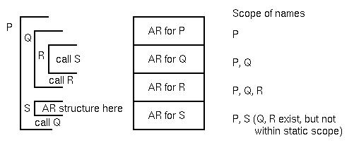
Pascal static scoping applied to functions

Slide 60
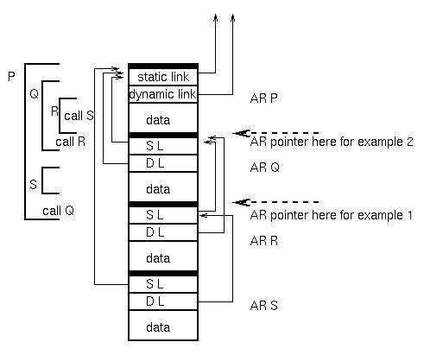

Slide 61
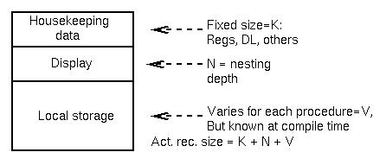

Slide 62
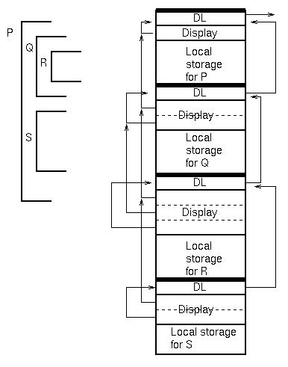

Slide 63
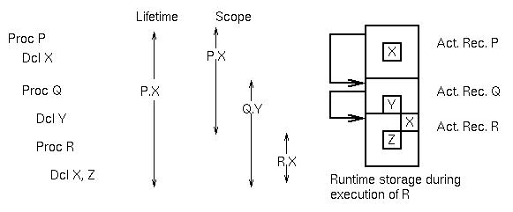

Slide 64
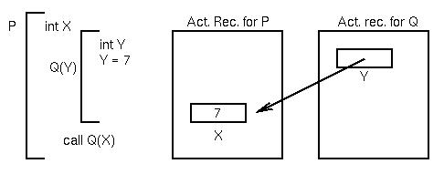

Slide 65
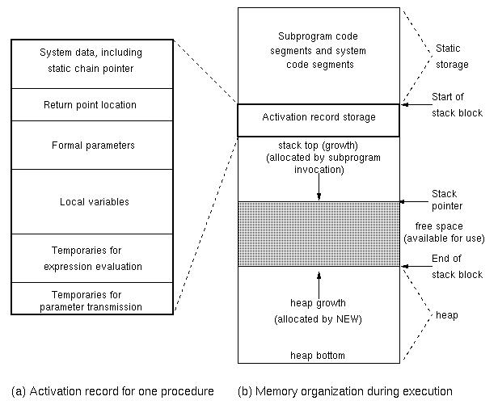

Slide 66
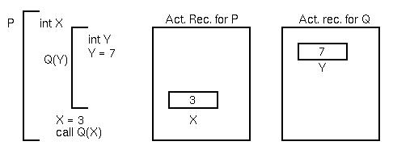

Slide 67
